Slide 1
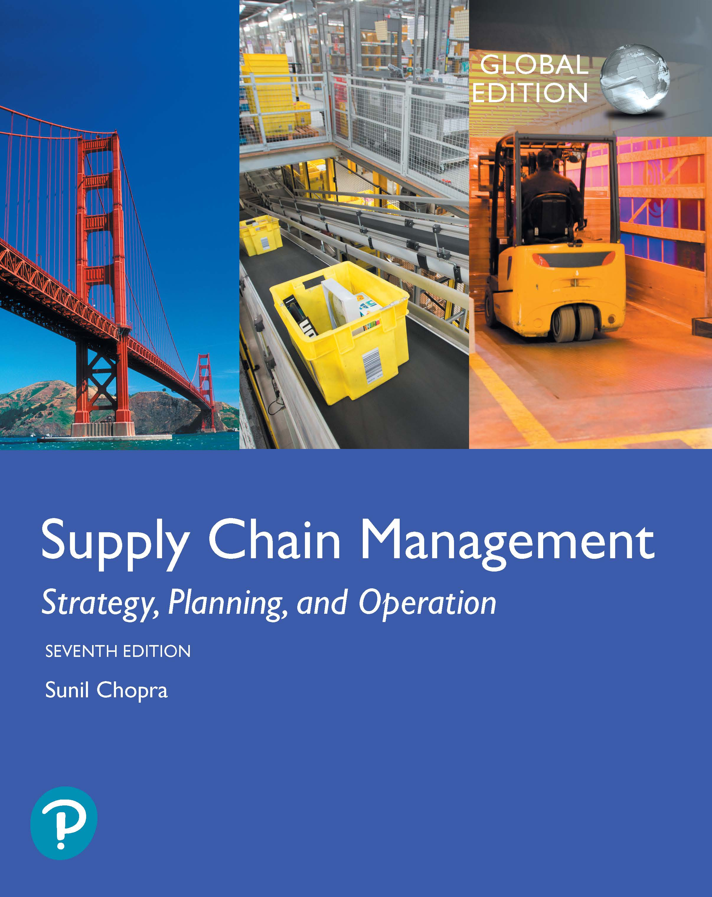
Supply Chain Management: Strategy, Planning, and Operation
Seventh Edition, Global Edition
Chapter 8
Aggregate Planning in a Supply Chain
Copyright © 2019 Pearson Education, Ltd.
Notes:
If this PowerPoint presentation contains mathematical equations, you may need to check that your computer has the following installed:
1) MathType Plugin
2) Math Player (free versions available)
3) NVDA Reader (free versions available)

Slide 2
Learning Objectives
8.1 Describe aggregate planning and its importance as a supply chain activity.
8.2 Explain the basic trade-offs to consider when creating an aggregate plan.
8.3 Model and solve the aggregate planning problem as a linear program.
8.4 Formulate and solve basic aggregate planning problems using Microsoft Excel.

Slide 3
Aggregate Planning and Its Role in a Supply Chain
Capacity has a cost and lead times are often long
Aggregate planning:
Given the demand forecast for each period in the planning horizon, determine the production level, inventory level, capacity level (internal and outsourced), and any backlogs (unmet demand) for each period that maximize the firm’s profit over the planning horizon.
How can a firm best use the facilities it has?

Slide 4
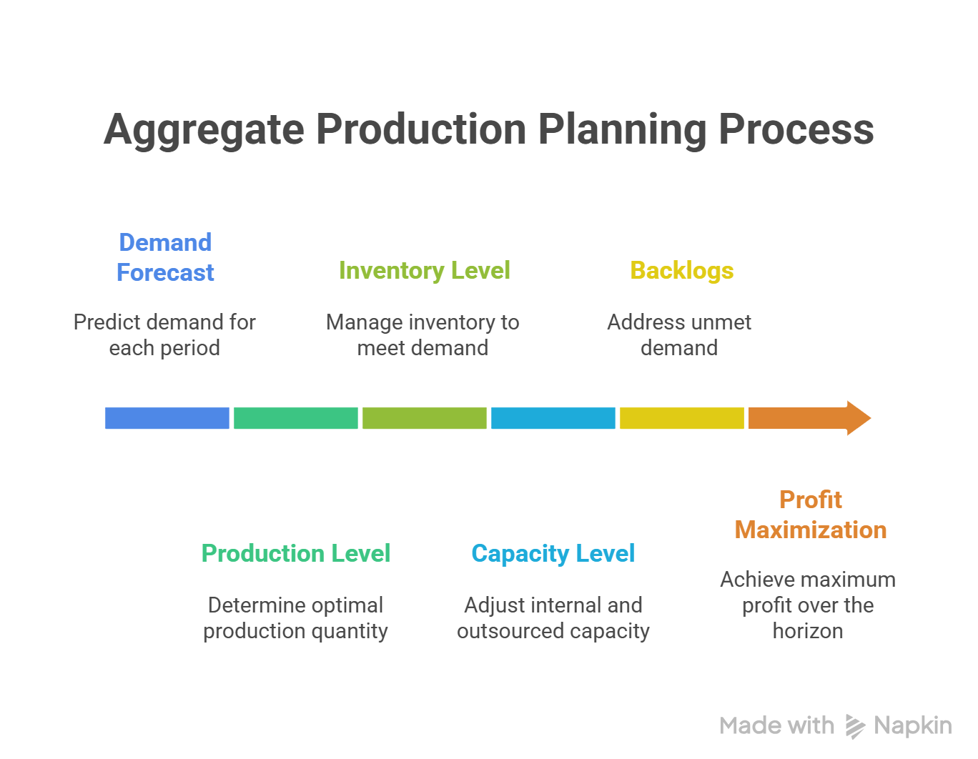

Slide 5
Role of Aggregate Planning in a Supply Chain
Identify operational parameters over the specified time horizon
Production rate
Workforce
Overtime
Machine capacity level
Subcontracting
Backlog
Inventory on hand
All supply chain stages should work together on an aggregate plan that will optimize supply chain performance

Slide 6
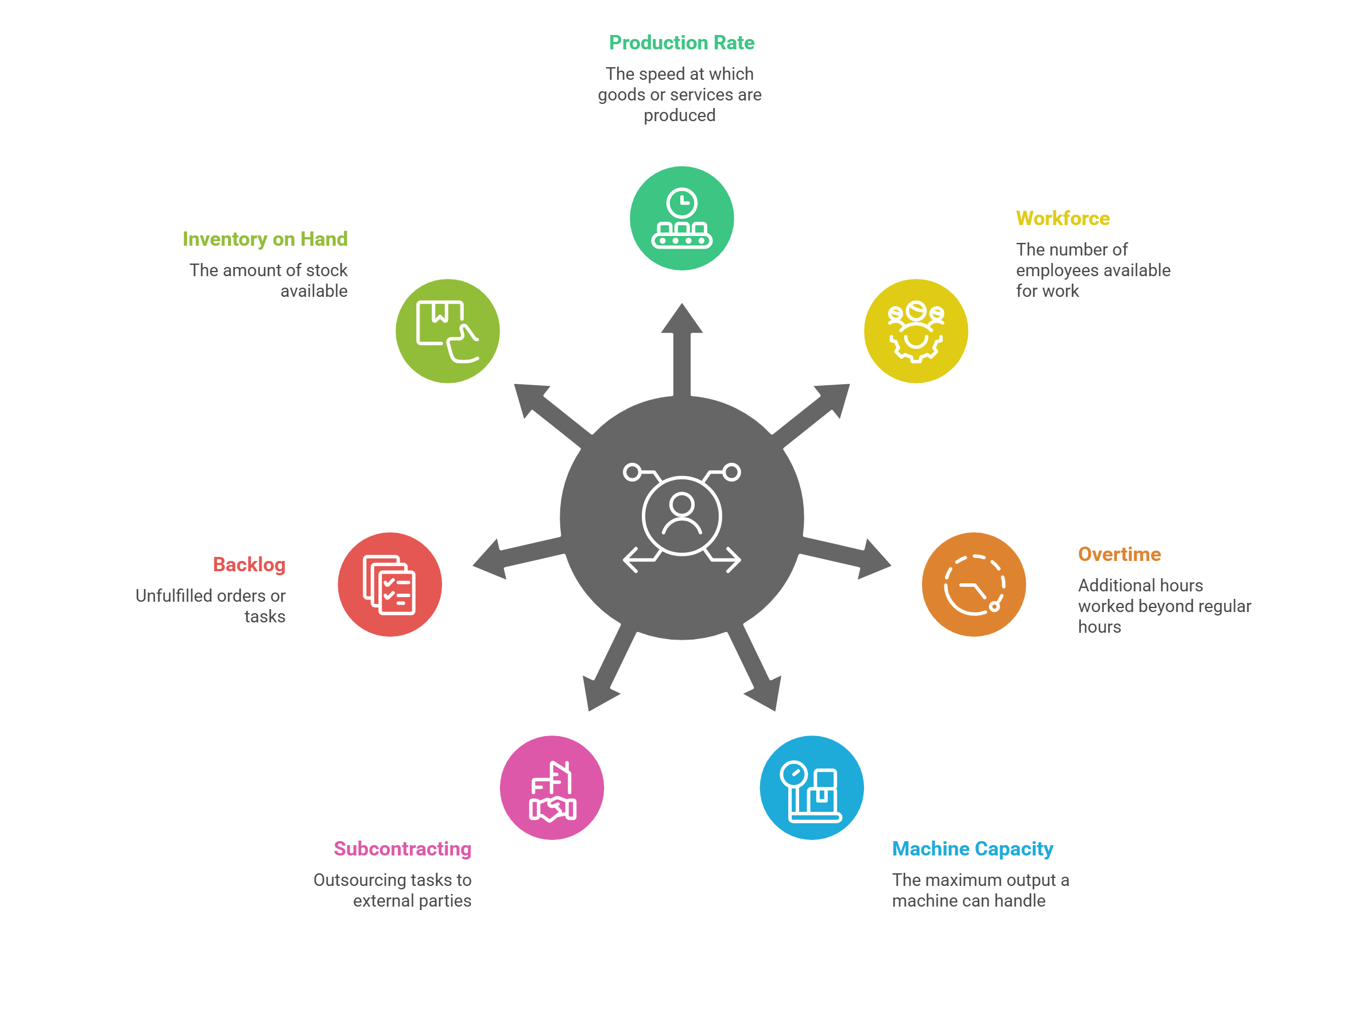

Slide 7
The Aggregate Planning Problem
Given the demand forecast for each period in the planning horizon, determine the production level, inventory level, and the capacity level for each period that maximizes the firm’s (supply chain’s) profit over the planning horizon
Specify the planning horizon (typically 3-18 months)
Specify the duration of each period
Specify key information required to develop an aggregate plan

Slide 8
Information Needed for An Aggregate Plan
Aggregate demand forecast F_{t} for each Period t over T periods
Production costs
Labor costs, regular time ($/hr) and overtime ($/hr)
Subcontracting costs ($/hr or $/unit)
Cost of changing capacity – hiring or layoff ($/worker), adding or reducing machine capacity ($/machine)
Labor/machine hours required per unit
Inventory holding cost ($/unit/period)
Stockout or backlog cost ($/unit/period)
Constraints – overtime, layoffs, capital available, stockouts, backlogs, from suppliers

Slide 9
Outputs of Aggregate Plan
Production quantity from regular time, overtime, and subcontracted time
Inventory held
Backlog/stockout quantity
Workforce hired/laid off
Machine capacity increase/decrease
A poor aggregate plan can result in lost sales, lost profits, excess inventory, or excess capacity

Slide 10
Summary of Learning Objective 1 (1 of 2)
To create an aggregate plan, a planner needs a demand forecast, cost and production information, and any supply constraints. The demand forecast consists of an estimate of demand for each period of time in the planning horizon. The production and cost data consist of capacity levels and costs to raise and lower them, production costs, costs to store the product, costs of stocking out the product, and any restrictions that limit these factors. Supply constraints determine limits on outsourcing, overtime, or materials. The aggregate plan then determines capacity, production, and inventory decisions over the next 3 to 18 months

Slide 11
Summary of Learning Objective 1 (2 of 2)
Good aggregate planning is done in collaboration with both customers and suppliers because accurate input is required from both stages. The quality of these inputs, in terms of both the demand forecast to be met and the constraints to be dealt with, determines the quality of the aggregate plan. The results of the aggregate plan must also be shared across the supply chain because they influence activities for both customers and suppliers. For suppliers, the aggregate plan determines anticipated orders; for customers, the aggregate plan determines planned supply.

Slide 12
Basic Tradeoffs in Aggregate Planning
Trade-off between capacity, inventory, backlog/lost sales
Chase strategy – using capacity as the lever
Flexibility strategy – using utilization as the lever
Level strategy – using inventory as the lever
Tailored or hybrid strategy – a combination of strategies

Slide 13
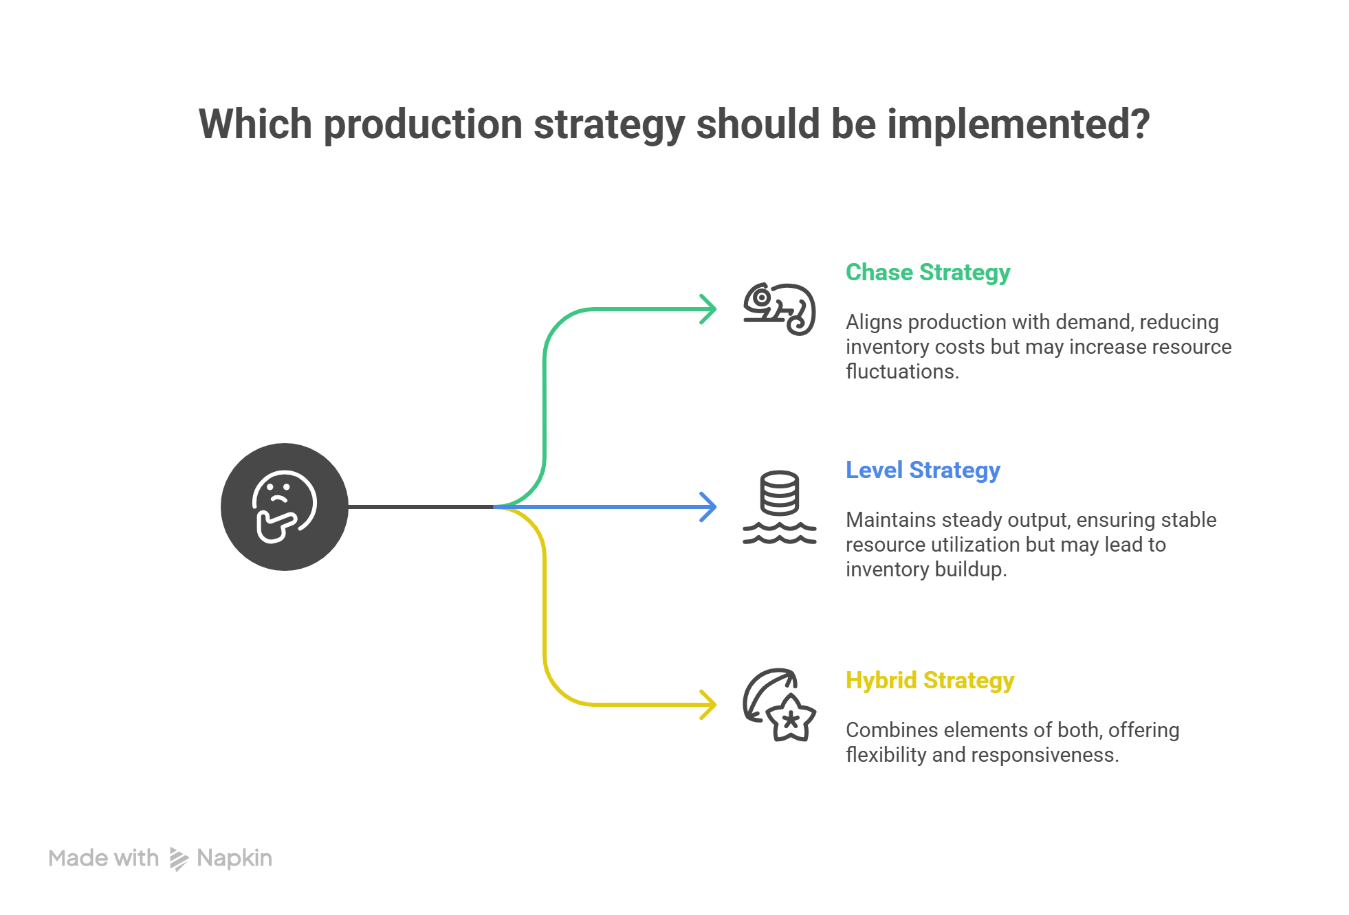

Slide 14
Chase Strategy
Vary machine capacity or hire and lay off workers as demand varies
Often difficult to vary capacity and workforce on short notice
Expensive if cost of varying capacity is high
Negative effect on workforce morale
Results in low levels of inventory
Used when inventory holding costs are high and costs of changing capacity are low

Slide 15
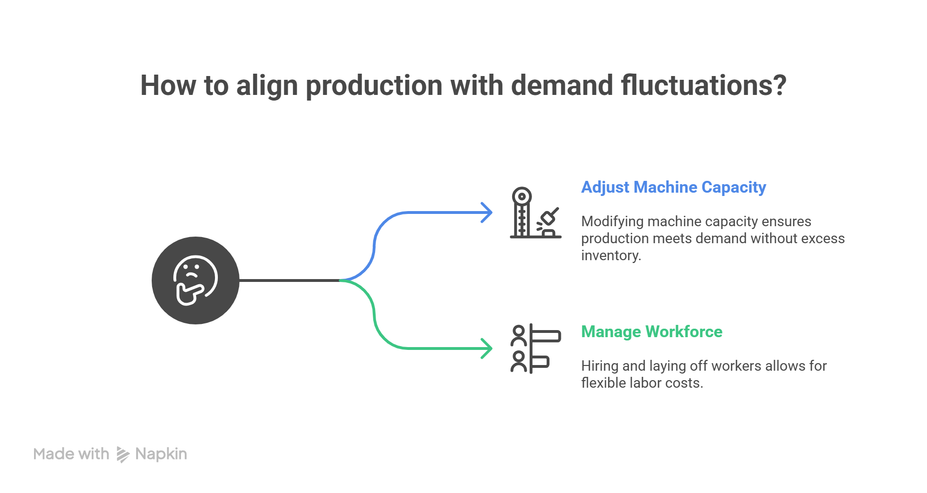

Slide 16
Utilization Flexibility Strategy
Use excess machine capacity
Workforce stable, number of hours worked varies
Use overtime or a flexible work schedule
Flexible workforce, avoids morale problems
Low levels of inventory, lower utilization
Used when inventory holding costs are high and capacity is relatively inexpensive

Slide 17
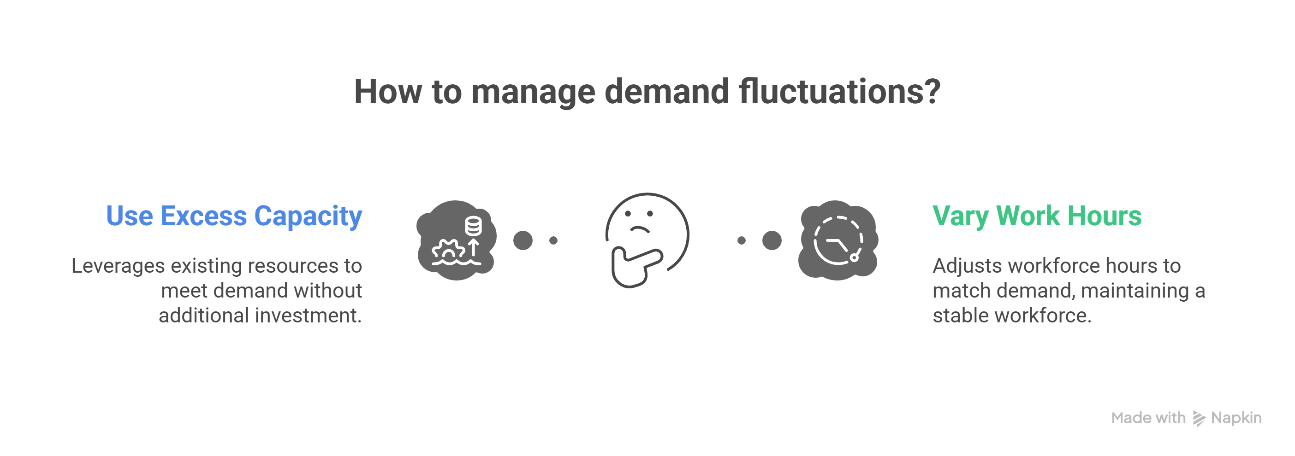

Slide 18
Level Strategy
Stable machine capacity and workforce levels, constant output rate
Inventory levels fluctuate over time
Inventories carried over from high to low demand periods
Better for worker morale
Large inventories and backlogs may accumulate
Used when inventory holding and backlog costs are relatively low

Slide 19
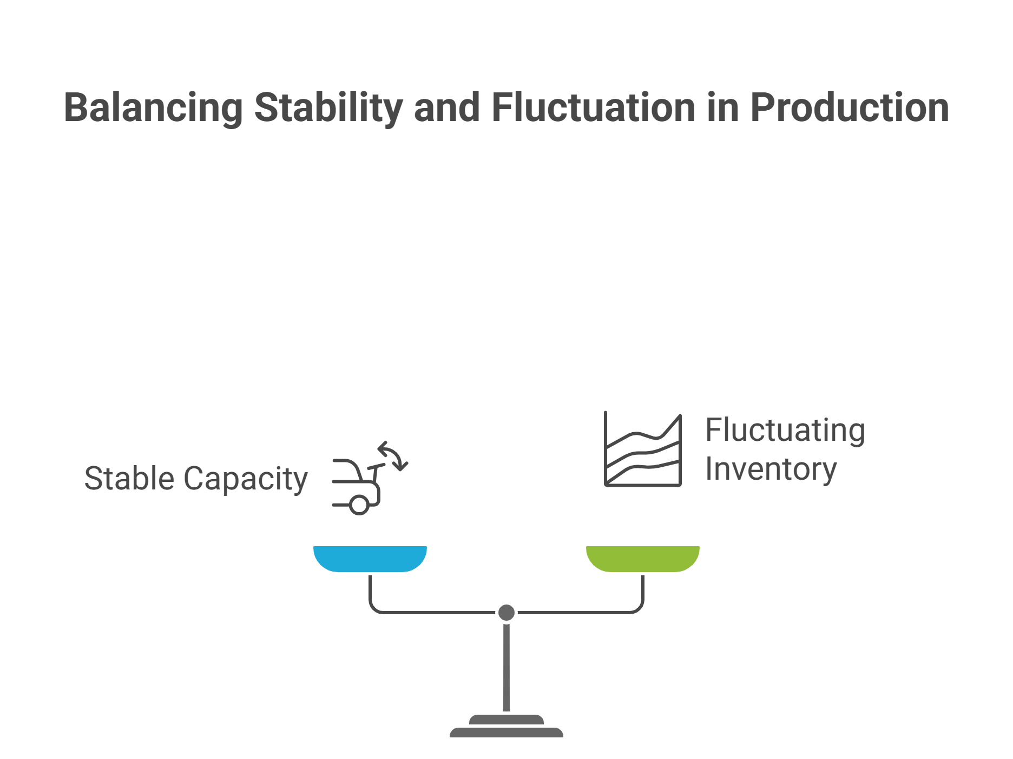

Slide 20
Summary of Learning Objective 2
The basic trade-offs in aggregate planning involve balancing the cost of capacity, the cost of inventory, and the cost of stockouts to maximize profitability. Increasing any one of the three allows the planner to lower the other two.

Slide 21
Aggregate Planning Using Linear Programming
Maximize profits while respecting supply chain constraints
Red Tomato Tools
Capacity determined mainly by workforce size

Slide 22
Identifying Aggregate Units of Production
Aggregate unit should be identified in a way that the resulting production schedule can be accomplished in practice
Focus on the bottlenecks when selecting the aggregate unit and identifying capacity and production times
Account for activities such as setups and maintenance

Slide 23
Red Tomato Tools (1 of 8)
Table 8-1 Costs, Revenues, and Times at Red Tomato Tools
Family | Material Cost/ Unit ($) | Revenue/ Unit ($) | Setup Time/Batch (hour) | Average Batch Size | Production Time/ Unit (hour) | Net Production Time/Unit (hour) | Percentage Share of Units Sold
A | 15 | 54 | 8 | 50 | 5.60 | 5.76 | 10
B | 7 | 30 | 6 | 150 | 3.00 | 3.04 | 25
C | 9 | 39 | 8 | 100 | 3.80 | 3.88 | 20
D | 12 | 49 | 10 | 50 | 4.80 | 5.00 | 10
E | 9 | 36 | 6 | 100 | 3.60 | 3.66 | 20
F | 13 | 48 | 5 | 75 | 4.30 | 4.37 | 15

Slide 24
Red Tomato Tools (2 of 8)
Weighted average approach
Material cost per aggregate unit
= (15 × 0.10) + (7 × 0.25) + (9 × 0.20)
+ (12 × 0.10) + (9 × 0.20) + (13 × 0.15)
= $10
Similarly
Revenue per aggregate unit = $40
Net production time per aggregate unit = 4.00 hours

Slide 25
Demand and Costs (1 of 3)
Highly seasonal demand
Options
Adding workers during peak times
Subcontract
Build up inventory
Develop a forecast

Slide 26
Demand and Costs (2 of 3)
Table 8-2 Demand Forecast
Month | Demand Forecast
January | 1,600
February | 3,000
March | 3,200
April | 3,800
May | 2,200
June | 2,200

Slide 27
Demand and Costs (3 of 3)
Starting inventory in January = 1,000
20 working days each month
Employees earn $4/hour regular time
Regular time = 8 hours/day, then overtime
Maximum 10 hours overtime/employee/month
End June with 500 units in inventory

Slide 28
Red Tomato Tools (3 of 8)
Table 8-3 Costs for Red Tomato
Item | Cost
Material cost | $10/unit
Inventory holding cost | $2/unit/month
Marginal cost of stockout/backlog | $5/unit/month
Hiring and training costs | $300/worker
Layoff cost | $500/worker
Labor hours required | 4/unit
Regular time cost | $4/hour
Overtime cost | $6/hour
Cost of subcontracting | $30/unit

Slide 29
Red Tomato Tools Decision Variables
For t = 1, ..., 6
W_{t} = Workforce size for month t
H_{t} = Number of employees hired at the beginning of month t
L_{t} = Number of employees laid off at the beginning of month t
P_{t} = Production in month t
I_{t} = Inventory at the end of month t
S_{t} = Number of units stocked out at the end of month t
C_{t} = Number of units subcontracted for month t
O_{t} = Number of overtime hours worked in month t

Slide 30
Red Tomato Tools Objective Function
Minimize
(Regular-time labor cost) + (Overtime labor cost) + (Cost of hiring and layoffs) + (Cost of holding inventory) + (Cost of stocking out) + (Cost of subcontracting) + (Material cost)

Slide 31
Red Tomato Tools Constraints
All for t = 1,..., 6
Workforce, hiring, and layoff constraints
Capacity constraints
Inventory balance constraints
Overtime limit constraints

Slide 32
Red Tomato Tools (4 of 8)
Total cost over planning horizon = $422,660
Table 8-4 Aggregate Plan for Red Tomato
Period, t | No. Hired, H_{t} | No. Laid Off, L_{t} | Workforce Size, W_{t} | Overtime, O_{t} | Inventory, I_{t} | Stockout, S_{t} | Subcontract, C_{t} | Total Production, P_{t} | Demand, D_{t}
0 | 0 | 0 | 80 | 0 | 1,000 | 0 | 0 | Blank | Blank
1 | 0 | 16 | 64 | 0 | 1,960 | 0 | 0 | 2,583 | 1,600
2 | 0 | 0 | 64 | 0 | 1,520 | 0 | 0 | 2,583 | 3,000
3 | 0 | 0 | 64 | 0 | 880 | 0 | 0 | 2,583 | 3,200
4 | 0 | 0 | 64 | 0 | 0 | 220 | 140 | 2,583 | 3,800
5 | 0 | 0 | 64 | 0 | 140 | 0 | 0 | 2,583 | 2,200
6 | 0 | 0 | 64 | 0 | 500 | 0 | 0 | 2,583 | 2,200

Slide 33
Red Tomato Tools (5 of 8)
Higher demand variability
Table 8-5 Demand Forecast with Higher Seasonal Fluctuation
Month | Demand Forecast
January | 1,000
February | 3,000
March | 3,800
April | 4,800
May | 2,000
June | 1,400

Slide 34
Red Tomato Tools (6 of 8)
Total cost over planning horizon = $433,080
Table 8-6 Optimal Aggregate Plan for Demand in Table 8-5
Period, t | No. Hired, H_{t} | No. Laid Off, L_{t} | Workforce Size, W_{t} | Overtime, O_{t} | Inventory, I_{t} | Stockout, S_{t} | Subcontract, C_{t} | Total Production, P_{t} | Demand, D_{t}
0 | 0 | 0 | 80 | 0 | 1,000 | 0 | 0 | Blank | Blank
1 | 0 | 16 | 64 | 0 | 2,560 | 0 | 0 | 2,560 | 1,000
2 | 0 | 0 | 64 | 0 | 2,120 | 0 | 0 | 2,560 | 3,000
3 | 0 | 0 | 64 | 0 | 880 | 0 | 0 | 2,560 | 3,800
4 | 0 | 0 | 64 | 0 | 0 | 1,220 | 140 | 2,560 | 4,800
5 | 0 | 0 | 64 | 0 | 0 | 660 | 0 | 2,560 | 2,000
6 | 0 | 0 | 64 | 0 | 500 | 0 | 0 | 2,560 | 1,400

Slide 35
Red Tomato Tools (7 of 8)
Lower hiring and layoff costs – $50
Total cost over planning horizon = $412,770
Table 8-7 Optimal Aggregate Plan for Hiring and Layoff Cost of $50/Worker
Period, t | No. Hired, H_{t} | No. Laid Off, L_{t} | Workforce Size, W_{t} | Overtime, O_{t} | Inventory, I_{t} | Stockout, S_{t} | Subcontract, C_{t} | Total Production, P_{t} | Demand, D_{t}
0 | 0 | 0 | 80 | 0 | 1,000 | 0 | 0 | Blank | Blank
1 | 0 | 35 | 45 | 0 | 1,200 | 0 | 0 | 1,800 | 1,600
2 | 0 | 0 | 45 | 0 | 0 | 0 | 0 | 1,800 | 3,000
3 | 42 | 0 | 87 | 0 | 280 | 0 | 0 | 3,480 | 3,200
4 | 1 | 0 | 88 | 0 | 0 | 0 | 0 | 3,520 | 3,800
5 | 0 | 27 | 61 | 0 | 240 | 0 | 0 | 2,440 | 2,200
6 | 0 | 0 | 61 | 0 | 500 | 0 | 20 | 2,440 | 2,200

Slide 36
Red Tomato Tools (8 of 8)
Building a Rough Master Production Schedule
Table 8-8 Disaggregating the Aggregate Plan at Red Tomato Tools for Period 1
Product | Setup Time/ Batch (hour) | Average Batch Size | Production Time/ Unit (hour) | Production Quantity | Number of Setups | Setup Time (hours) | Production Time (hours)
A | 8 | 50 | 5.60 | 256 | 5 | 40 | 1,433.6
B | 6 | 150 | 3.00 | 640 | 4 | 24 | 1,920.0
C | 8 | 100 | 3.80 | 512 | 5 | 40 | 1,945.6
D | 10 | 50 | 4.80 | 256 | 5 | 50 | 1,228.8
E | 6 | 100 | 3.60 | 512 | 5 | 30 | 1,843.2
F | 5 | 75 | 4.30 | 384 | 5 | 25 | 1,651.2
Planned production and setup = 10,231.4 hrs Available production time = 10,240 hrs

Slide 37
Summary of Learning Objective 3
Given the goal of maximizing profits (or minimizing costs) subject to supply chain constraints, the aggregate planning problem can be modeled as a linear program. The first step is to identify a suitable aggregate unit of production and forecast demand in terms of the aggregate unit. The next step is to identify the various costs (such as material, inventory, production) and constraints in the supply chain. We then identify the set of decision variables and construct the objective function and constraints in terms of the decision variables. Linear programming then allows us to optimize the objective function subject to the specified constraints. The aggregate plan should then be converted to a feasible master production schedule.

Slide 38
Aggregate Planning in Excel
Table 8-9 Building the Basic Aggregate Planning Spreadsheet
Output | Cells | Relationship to inputs | Formula in Row 5 | Copied to Calls
Workforce | D5:D10 | W sub t = W sub t minus 1 + H sub t minus L sub t. | = D4 + B5 – C5 | D6:D10
Production | I5:I10 | P sub t = 40 times W sub t plus start fraction O sub t over 4 end fraction. | = 40 times D 5 + left parenthesis E 5 over 4 right parenthesis | I6:I10
Inventory | F5:F10 | I sub t = max of left parenthesis I sub t minus 1 plus P sub t + C sub t minus D sub t minus S sub t minus 1, 0 right parenthesis | = max left parenthesis F 4 + I 5 + H 5 minus G 4 minus J 5, 0 right parenthesis | F6:F10
Stockout | G5:G10 | S sub t minus max left parenthesis 0, S, sub t minus 1 + D sub t + I sub t minus 1 minus P sub t minus c sub t | Equals max of left parenthesis 0, J 5 + G 4 minus I 5, minus H 5 minus F 4 | G6:G10

Slide 39
Aggregate Planning Using Solver (1 of 8)
Figure 8-1 Basic Aggregate Planning Spreadsheet

Slide 40
Aggregate Planning Using Solver (2 of 8)
For t = 1, ..., 6
W_{t} = Workforce size for Month t
H_{t} = Number of employees hired at the beginning of Month t
L_{t} = Number of employees laid off at the beginning of Month t
P_{t} = Production in Month t
I_{t} = Inventory at the end of Month t
S_{t} = Number of units stocked out at the end of Month t
C_{t} = Number of units subcontracted for Month t
O_{t} = Number of overtime hours worked in Month t

Slide 41
Aggregate Planning Using Solver (3 of 8)
Figure 8-2 Spreadsheet Area for Decision Variables

Slide 42
Aggregate Planning Using Solver (4 of 8)
Figure 8-3 Spreadsheet Area for Constraints

Slide 43
Aggregate Planning Using Solver (5 of 8)
Figure 8-4 Spreadsheet Area for Cost Calculations

Slide 44
Aggregate Planning Using Solver (6 of 8)
Set Target Cell: C22
Equal to: Select Min
By Changing Cells: B5:I10
Subject to the constraints:
B5:C10 = integer {Number of workers hired or laid off is integer}

Slide 45
Aggregate Planning Using Solver (7 of 8)
{Inventory at end of Period 6 is at least 500}
G10 = 0 {Stockout at end of Period 6 equals 0}

Slide 46
Aggregate Planning Using Solver (8 of 8)
Figure 8-5 Solver Parameters Dialog Box

Slide 47
Forecast Error in Aggregate Plans (1 of 2)
Forecast errors must be considered, flexibility must be built in
Safety inventory
Build and carry extra inventories to satisfy higher than forecasted demand

Slide 48
Forecast Error in Aggregate Plans (2 of 2)
Safety capacity
Capacity used to satisfy higher than forecast demand
Use overtime as a form of safety capacity
Carry extra workforce permanently as a form of safety capacity
Use subcontractors as a form of safety capacity
Build and carry extra inventories as a form of safety inventory
Purchase capacity or product from an open or spot market as a form of safety capacity

Slide 49
The Role of Software in Aggregate Planning
The ability to handle large amounts of data
Develop optimal solutions using linear programming
The ability to handle complex problems (often using linear approximations of nonlinear functions)
Stability and data accuracy are important

Slide 50
Summary of Learning Objective 4
Aggregate planning problems can be solved in Excel by setting up cells for the objective function and the constraints and using the Solver tool to produce the solution. It is best if these plans can account for forecast error, resulting in a plan that has some degree of stability.

